Slide 1
IncredibleHack Problem 2
CodeRiders
Raja Sekhar Reddy

Slide 2
Technologies Used
R Language
R Packages Used:
DT
shiny
shinythemes

Slide 3
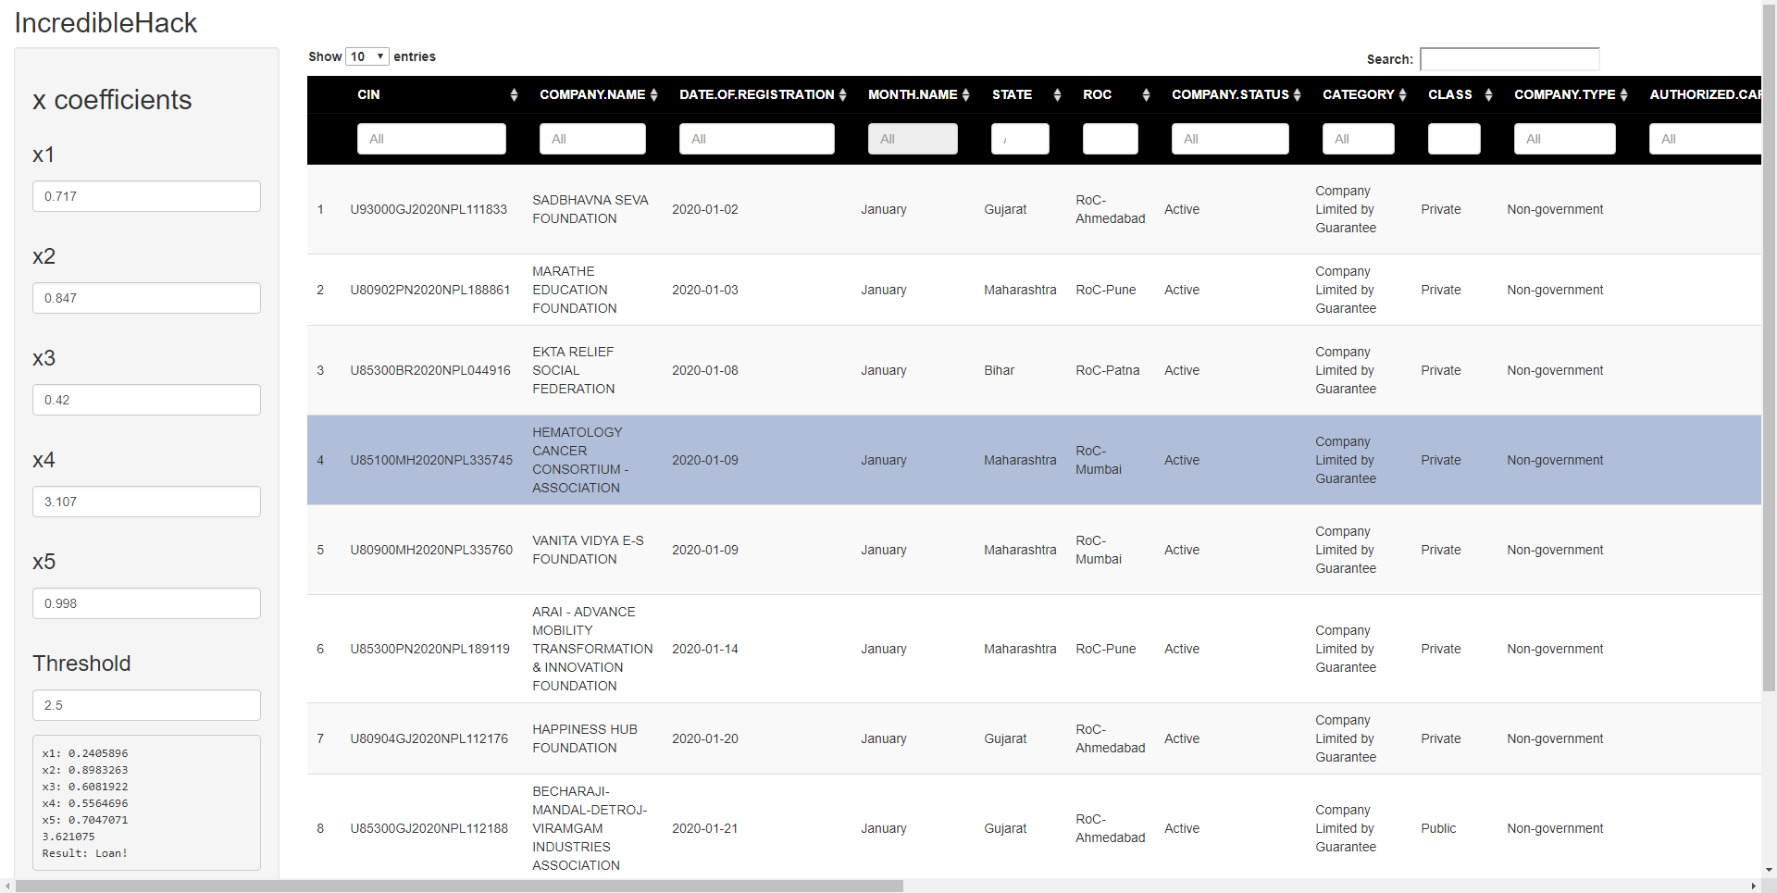
UI Design

Slide 4
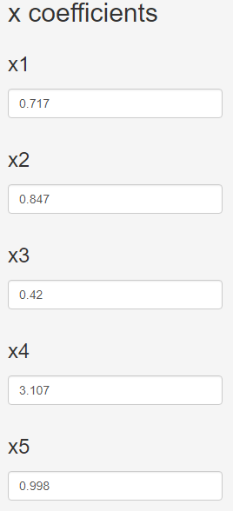
Configurable Coefficients

Slide 5
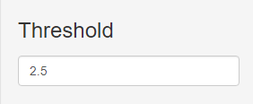
Configurable Threshold

Slide 6

Table level Search functionality

Slide 7
Column level search

Slide 8
Pagination

Slide 9
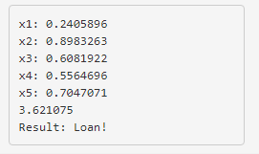
Dynamic result on selection

